Slide 1

Learning Algorithms applied in energy management of hybrid vehicles

Slide 2
*Introduction
*Hybrid Cars
*Importance of fuel efficiency
*Differences between ICEV, Hybrid vehicle & Electric Vehicle
*Classification of Hybrids
→Parallel Hybrids
→Series Hybrids
→Plug-in Hybrids
→Mild Hybrids
*Why Hybrid Cars?
*How Hybrid Cars works?
*Problem with Hybrid Cars
*Impact of Hybrid Cars on Environment
*Advantages and Disadvantages
*Conclusion
CONTENT

Slide 3
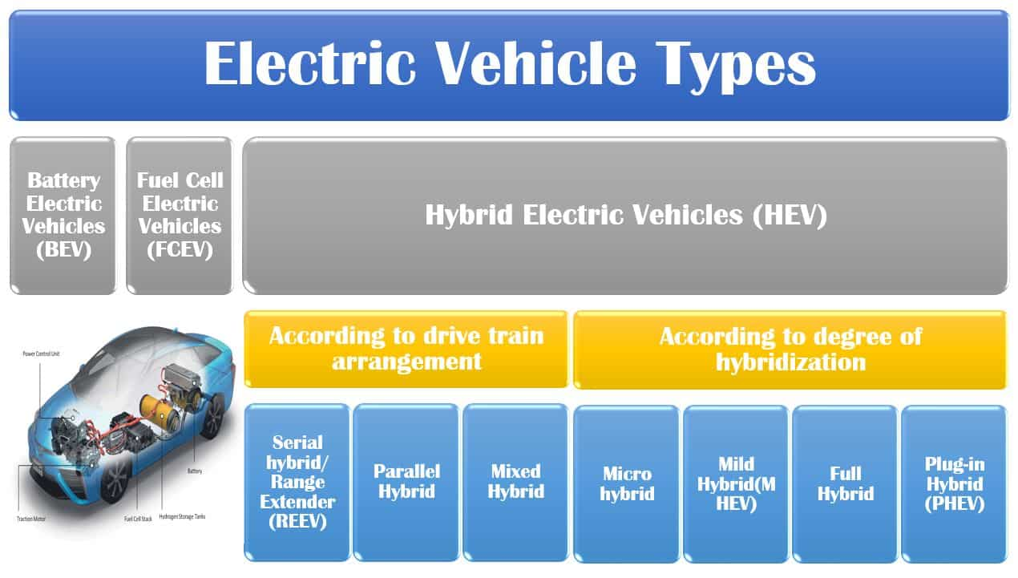
INTRODUCTION
In an era where energy conservation is a developing "trend" not only among the learned but also among the ordinary responsible citizens.
Fuel efficiency along with minimum pollution has become the benchmark for any new automobile
This Photo by Unknown author is licensed under CC BY-NC.

Slide 4
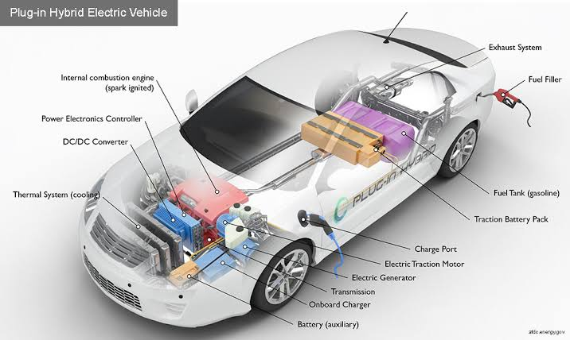
hybrid cars:
Hybrid car uses more than one means of energy, combining of a petrol or diesel engine with an electric motor, and the two systems work with each other to move the vehicle.
Hybrid cars allows the car to burn less gasoline, achieving better fuel efficiency than a traditional engine that solely uses fuel ones

Slide 5
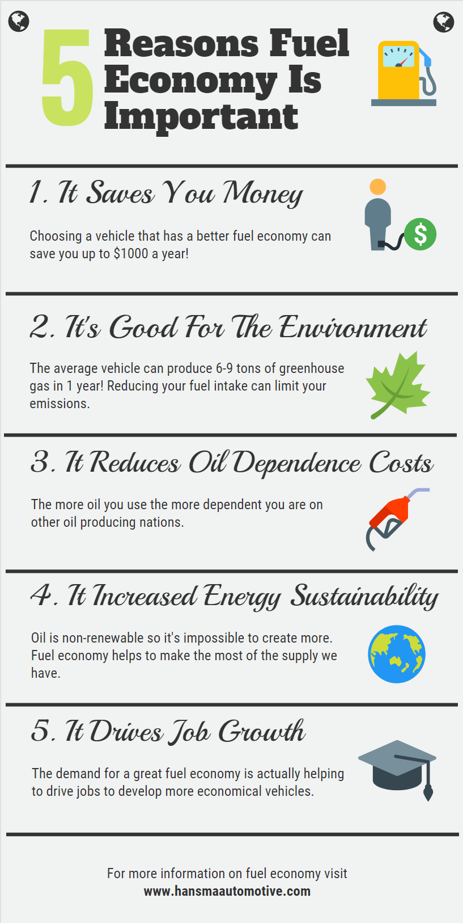
Importance of Fuel Efficiency
Vehicles with better fuel efficiency tend to consume less fuel to carry out the same task. Therefore, reducing wasted fuel. Choosing a fuel efficient vehicle can bring a wide range of advantages: saving fuel costs, reducing carbon footprint, cutting our dependence on oil.

Slide 6
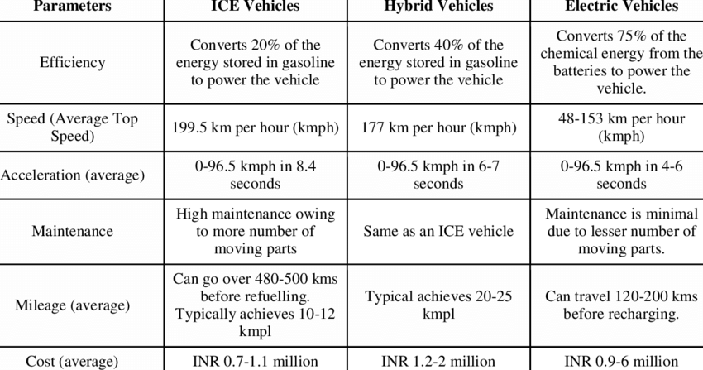

Slide 7
CLASSIFICATION OF HYBRID
Parallel hybrids
Series hybrids
Plug-in hybrids
Mild hybrids

Slide 8
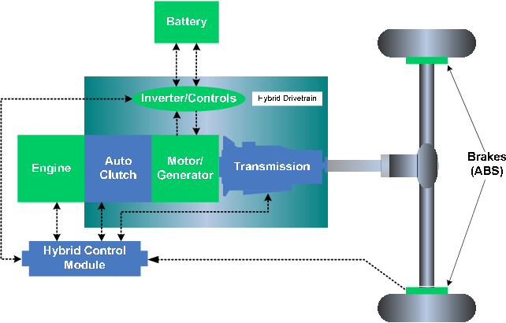
PARALLEL HYBRIDS
These are the most common type of hybrid in which an electric motor and gasoline engine are connected in common transmission that blends the two power sources.
The vehicles are powered either directly by a gas engine ,by an electric motor alone, combination of both.

Slide 9
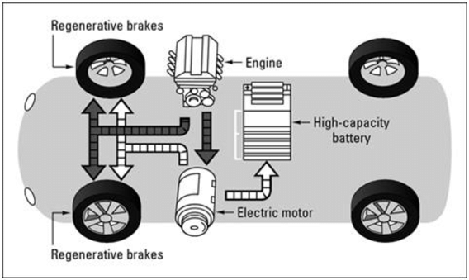
SERIES HYBRID
A gasoline engine is not connected to the wheels and only used to produce electricity for a generator that recharges the battery in the design .An electric motor serves to provide all the propulsion.

Slide 10
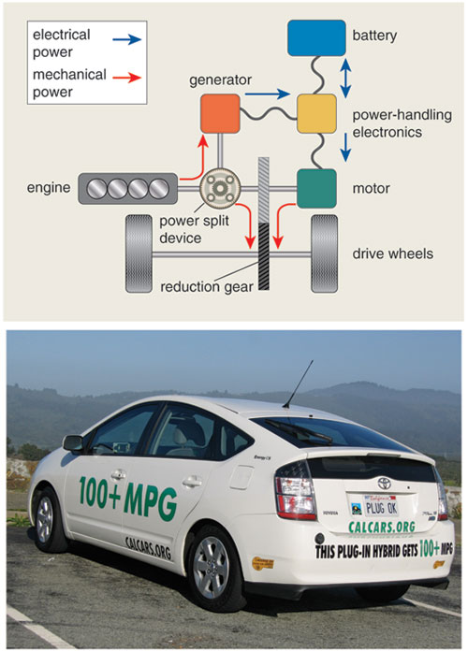
PLUG-IN HYBRIDS
In this design, the battery can be recharged by plug-in by external source of electricity. It has such a large battery that a daily commute can be completed on it's electric power only. .After the electric range has run out, the car functions as a conventional parallel hybrid.

Slide 11
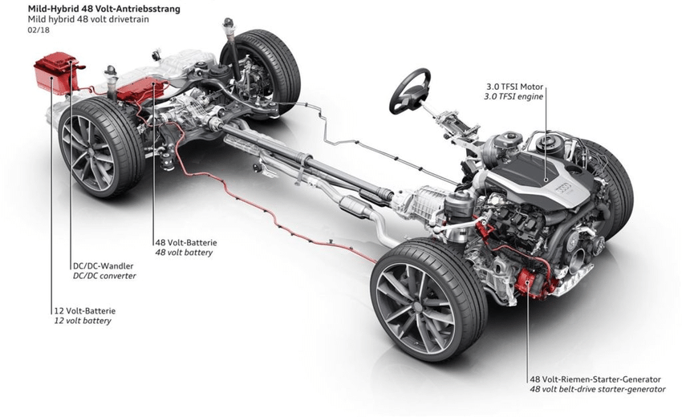
MILD HYBRIDS
In this type of hybrid an electric motor is capable of moving the car by self. A petrol or diesel engine do most of the work, and an electric motor serves to assist the gasoline engine in reducing fuel use, boosting performance or both

Slide 12

WHY HYBRID CARS?
As there is a constant raise in the fuel prices, it is must for us to look for alternatives such as hybrids.
Hybrids are the optimum mileage in it’s class.
Dependency on fossil fuels can be increased.
They produce much less emissions and use about 50% less fuel than the average new vehicle in the same class.

Slide 13
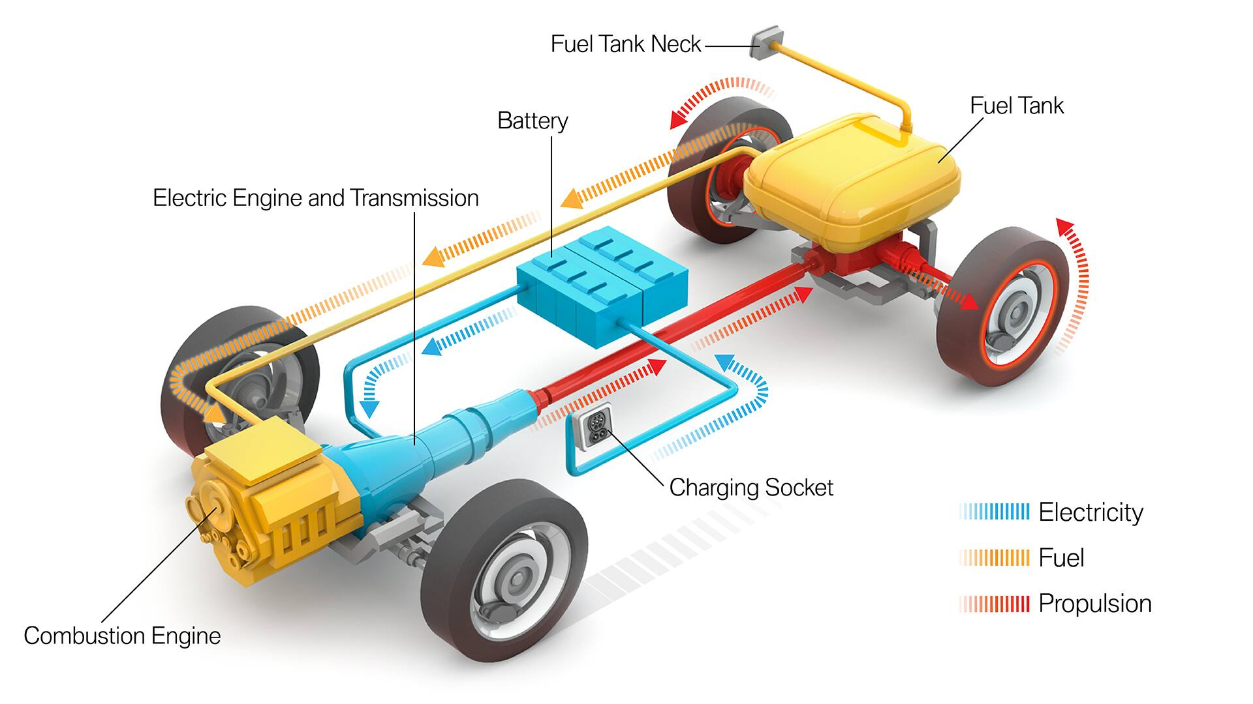
HOW HYBRID CARS WORKS?
→Hybrid cars integrate the power of the conventional gasoline engine with that of an electric motor.
→A high powered battery pack provides energy to the motor which itself gets recharged when the car is decelerating.
→The gas engine can also assist the battery recharging, which kills the need to plug the car to an external source of energy.
→Mild hybrids are incapable of independently operating the vehicle.

Slide 14
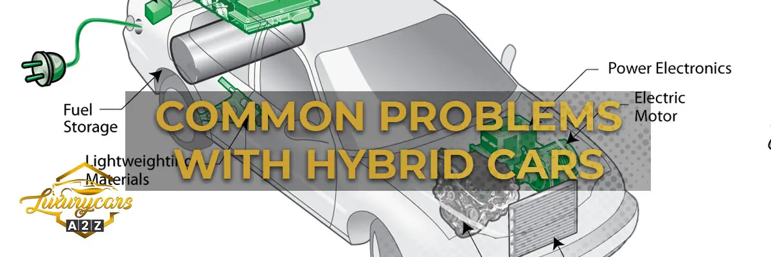
PROBLEM WITH HYBRID CARS:
THE ICE
The internal-combustion engine is the perfect thing to put your mind ease if you suffer from rains and anxiety, offering a handy back-up should the battery actually run-out of charge .
On the other hand it still emits harmful co2 emissions in to the atmosphere, which is useful the main thing people want to avoid when buying an electric vehicle.
POORER FUEL EFFECIENCY AND HANDLING
→HEV and PHEVs are packing to drivetrains into the one car, which means more weight, which can negatively effect fuel efficiency and handling, as well as the before mentioned need to compressed by downsizing both the battery and ICE.

Slide 15
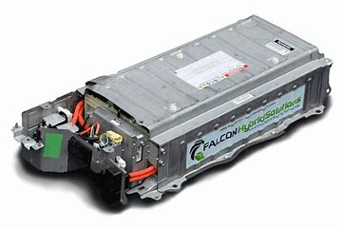
BATTERY PRODUCTION
→The lithium-ion batteries in hybrids and PHEVs use rare-earth metals , and the equipment used during the mining of these-specifically bulldozers and other mining machines- are diesel-powered, which flies in the phase of buying a hybrid or PHEV as a way to make a positive environmental impact.
BATTERY RECYCLING
→Extracting reusable elements from batteries is difficult and expensive process, meaning there is a long way to go before it’s done on a void, cost effective and environmentally friendly scale.

Slide 16
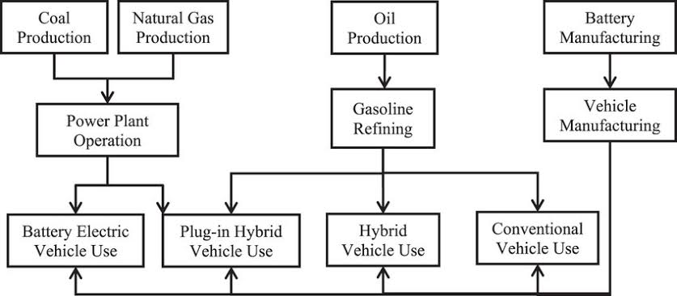

Slide 17
IMPACT OF HYBRID CARS ON ENVIRONMENT
Electrification is the most effective where to attain more cleanly and systematic transportation that are critical to the sustainable development of the world, this could be achieved by using battery technology.
Now a days many of vehicle manufacturers are facing to manufacture a vehicle which produce cleaner alternative fuel because most of the gasoline vehicle releases CO2 gases which are more than 99% of the carbon in fuel is emitted as CO2 when the fuel burned.
During acceleration this percentage increase and also other gases are emitted like hydrocarbons and carbon monoxide.
This carbon content may vary by fuel i.e., diesel vehicle create 10-15% more CO2 per gallon as compared to petrol vehicle.
By the theoretically this vehicles produces a cleaner alternative fuel but practically it is not possible, so it increases the amount of pollution emitted to air or environment.

Slide 18
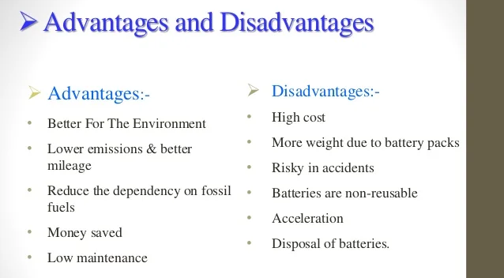

Slide 19
CONCLUSION:
HEV is a vehicle that uses two sources of power-gasoline and battery. For low power application battery drive is used whereas for high power application where power requirement is very high gasoline engine is used. Gasoline drive is most efficient at high speed drive. Thus HEVs both made of operation occurs at their maximum efficiency. But in gasoline engine low speed operation is not efficient. Its high speed mode is only efficient. Therefore, it gives twice mileage given by a normal vehicle. As this hybrid vehicle emits 50% less emission than normal vehicle it plays an important role for reducing pollution to certain extent without compromising with efficiency.

Slide 20

PRESENTED BY:
D. Sathwika
K. Sanjana

Slide 21


